Slide 1
Illinois Prescription Monitoring Program Opioid Advisory Council - February, 2018
Edward Dowllar
Stan Murzynski
Craig Berberet
Sarah Pointer

Slide 2
PMP Registrations
62,331 PMP Users (as of February 8, 2018)
25,573 registrations since December, 2017
51, 345 Prescribers
10,986 Dispensers
Six weeks behind on registrations

Slide 3
Registrations

Slide 4
Searches

Slide 5
Federal Grants
CDC – Prescription Drug Overdose – Prevention for States (Including two supplemental grants)
Enhance PMP
Community Intervention
SAMHSA State Targeted Response (DASA)
E.H.R. Connections
Harold Rogers PDMP Grant
Enhance PMP

Slide 6
PMP Projects Overview
Universal PMP Registration
Public Act 100-0564
Enhance PMP Website
E.H.R. Connectivity
Promote CDC Prescribing Guidelines
Daily PMP Reporting
Expand At-risk Patient Reporting
Conduct Public Health Surveillance
Provide Technical Assistance to Local Health Depts

Slide 7
PMP Projects Overview
Identify Medicaid Fraud
Assist with Medicaid Restriction Program
Identify Hot Spots in Illinois
Continuing Education
Academic Detailing
Dashboard
Website Redesign
Online Law Enforcement Access (Indirect Access)

Slide 8
PMP Projects Overview
Morphine Milligram Equivalent Calculator
Multiple Provider Episode Calculator
Prescriber Reports
Medical Marijuana
Awareness Campaign
Research
Designee Access
Identity Resolution

Slide 9
PMPnow
27 Connections (Illinois, Missouri and Iowa)
Facility type
22 hospitals
2 clinics
2 pain clinics
1 FQHC
3,243,825 searches in January, 2018
636 Sites
Includes ambulatory sites and ambulances
Three request types
35 facilities in the pipeline

Slide 10
PMPnow Outreach and Features
Marketing
EHR/Medication Management Vendor
Hospital/FQHC/Clinic/Prompt Care/Dental Office/Pharmacy Outreach
PMPnow Features
Interstate data via PMPnow
Patient Identity Resolution
MPE/MME (calculator)/ CDC 5 indicators integration
WE WILL CONNECT TO ANY HEALTHCARE ORGANIZATION THAT WOULD LIKE TO RECEIVE PMP DATA!!!

Slide 11
PMPnow Active Sites

Slide 12
PMPnow Searches
2,222,730
1,103,635

Slide 13
PMP Projects
PMP Website Updates
Verifications
Automated Registration/Verification
Forgot Password/User Name
Dashboard
FOIA Requests
PMPnow activation, outreach and marketing
Local Health Department Project
County reports (identifying hot spots)
Outreach and education
Naloxone
Medicinal Marijuana
Designees
Newsletter

Slide 14
PMP Projects
Academic Detailing
DPH
Dashboard
Awareness Campaign
Research Projects
Risk Factors for Fatal and Non-fatal Overdose
Continuing Education
MME; PMP data analysis; MPE reports

Slide 15
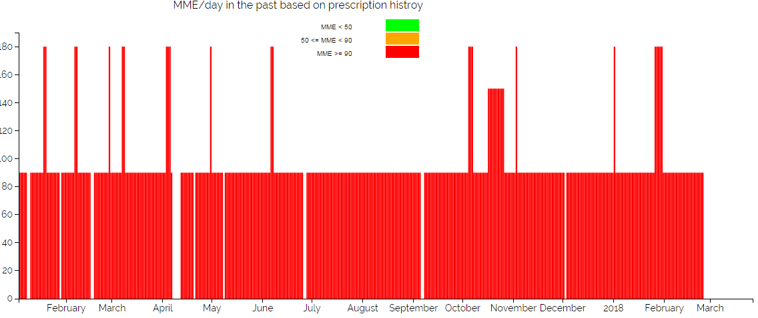

Slide 17
Upcoming Projects
Clustered Searching
User Patient Linking
RX Check hub
Prescriber Reports
DASA Drug Treatment facility finder
Patient Metric System
MME
MPE
Opioid Naivety
Opioid Benzo Overlap
Opioid Overlap
Medicinal Marijuana Patient Match
PMP website redesign

Slide 18
Upcoming Projects
Patient Alert System
Blog
Electronic Prescription Fixing
Stolen Prescription Pad Alert
CE Page
Prescriptive Authority Page (Collaborative Practice Agreement)
Update Login Procedures
Alerts/Issues in your area
PMP Direct Messaging system
Upgrade the LEOR system
PMP LTC Project
PMP instructional Videos
Pharmacy Compliance
Medicaid Restriction Program

Slide 19
PMP Hiring
Two current clinical database associates
Hiring five new positions
Two clinical database associates
Two clinical web developers
One project coordinator
Email Resume to dhs.pmp@illinois.gov

