Slide 1
An Introduction to The Census Bureau Language Mapper Application
Developed by:
Social Economic and Housing Statistics Division, U.S. Census Bureau

Slide 2
Purposes of the Mapper Application
Easily-accessible information about location of language needs
Information on languages used in various parts of the U.S.
Entry point into detailed language data from the American Community Survey

Slide 3
Outline
Overview of the American Community Survey
ACS: Speaking language other than English
ACS language data and Title VI
Using the mapper application
Using the TIGERweb application
Using American Factfinder to find detailed tables

Slide 4
An Overview of the American Community Survey
Notes:
4
The numbers that reflect our communities, traditionally, have been collected during the census every 10 years. Rather than taking a snapshot of a community once every ten years, the American Community Survey provides a dynamic and much timelier moving picture of the nation, every year.

Slide 5
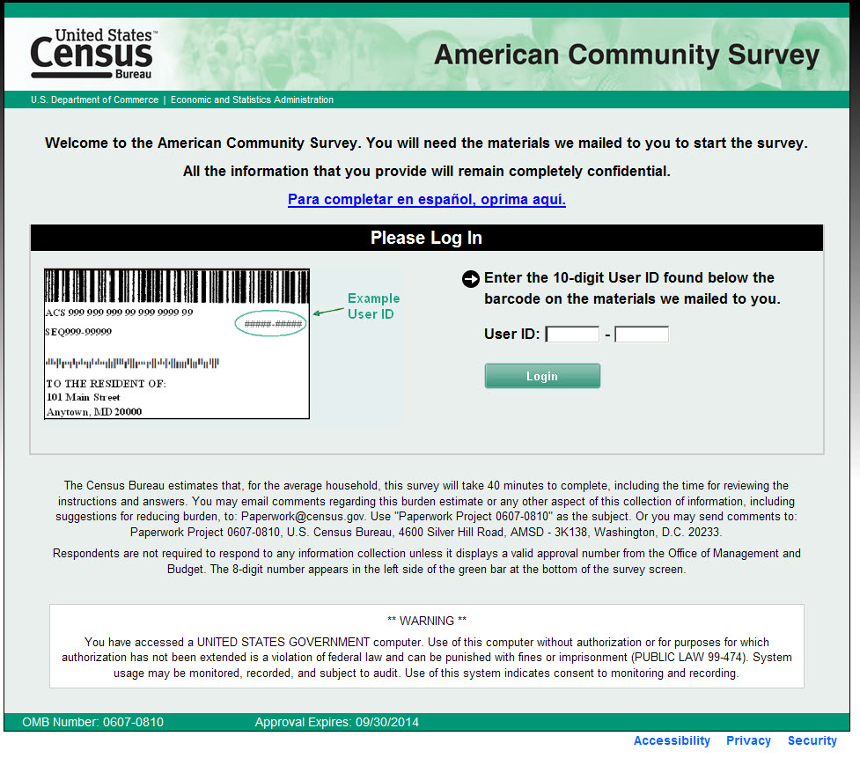
What is the American Community Survey (ACS)?
A large, continuous survey that:
produces characteristics of population and housing (similar to Census 2000 long form)
produces estimates for small areas and small population groups
samples approximately 3.54 million resident addresses per year (about 290,000 per month)
Notes:
The American Community Survey, sometimes referred to as the ACS, is a nationwide survey that produces characteristics of the population and housing, similar to the long-form questionnaire used in Census 2000. The American Community Survey produces these estimates for small areas and small population groups. The American Community Survey is a continuous survey, in which each month a sample of housing unit addresses receives a questionnaire. About 3.5 million addresses are surveyed each year.

Slide 6
Target Population
Resident population of the United States and Puerto Rico living in housing units and group quarters (GQ)
Housing units: house, apartment, mobile home or trailer, a group of rooms, or a single room occupied as separate living quarters
Group quarters: Place where people live or stay that is normally owned or managed by an entity or organization providing housing or services for the residents.
Current residents at the selected address
“Two month” rule
Year-round data collection (12 months/year)
Notes:
6
The American Community Survey collects data from all persons without regard to their legal status or citizenship.
Starting in 2006, and for every year thereafter, the American Community Survey has included the resident population living in BOTH housing units and group quarters.
The group quarters population is divided into two categories, the Institutional group quarters population and the Non-institutional group quarters population.

Slide 7
Population Thresholds for ACS Estimates
 | 1-year estimates | 3-year estimates | 5-year estimates
65,000+ people | X | X | X
20,000+ people |  | X | X
Less than 20,000 people |  |  | X
7
Notes:
The types of ACS estimates published for a particular area are based on established population thresholds.
Geographic areas with at least 65,000 people will receive one-year, three-year, and five-year ACS estimates.
Areas with less than 20,000 people, down to the block group level, will only receive five-year estimates.
7

Slide 8
Comparing Across Geographies
Only compare the same type of estimate
1-year estimates to other 1-year estimates
3-year estimates to other 3-year estimates
5-year estimates to other 5-year estimates
Same time period
8
Notes:
8
Comparisons across different geographies should be made with estimates of comparable period length and of the same time period. For example, to make comparisons of educational attainment across several geographies use the same period for each geography, such as 2005-2007.

Slide 9
Topics Covered by the ACS (Partial list)
Sex and Age
Race and Hispanic Origin
Ancestry
Citizenship Status
Place of Birth
Year of Entry
Migration
Journey to Work - Residence
Journey to Work - Workplace
Relationship and Marital Status
School Enrollment
Educational Attainment
Language Use and English Ability
Disability
Income, Earnings and Poverty
Veterans
Transfer Programs
Employment Status
Industry and Occupation
Health Insurance
Computer and Internet Use
Housing Occupancy and Vacancy
Owner Costs
Renter Statistics
Value of Home
Vehicles Available
For more information see www.census.gov/acs
Notes:
This is not a complete list of topics. The best way to see that is to look at the questionnaire itself, on the web site. We can point out a few items that may be of interest, including age, race, Hispanic origin, disability, and language use. We also have information on commuting, based on places where people live and places people go to work.

Slide 10
American Community Survey: Population Speaking a Language Other than English

Slide 11
ACS question on language use and English ability
Notes:
All data on language collected by the Census Bureau make use of this basic set of three questions originally developed for the 1980 Census.

Slide 12
Coding of languages
Write-ins are coded to 3-digit codes
381 possible languages
Over 300 were reported in recent years of ACS
Most detailed general table shows 39 languages

Slide 13
39 Language groups
1. Spanish or Spanish Creole
3. Asian and Pacific Island languages
Chinese
Japanese
Korean
Mon-Khmer, Cambodian
Hmong
Thai
Laotian
Vietnamese
Other Asian languages
Tagalog
Other Pacific Island languages
2. Other Indo-European languages
French (incl. Patois, Cajun)
French Creole
Italian
Portuguese or Portuguese Creole
German
Yiddish
Other West Germanic languages
Scandinavian languages
Greek
Russian
Polish
Serbo-Croatian
Other Slavic languages
Armenian
Persian
Gujarati
Hindi
Urdu
Other Indic languages
Other Indo-European languages
4. Other Languages
Navajo
Other Native North American languages
Hungarian
Arabic
Hebrew
African languages
Other and unspecified languages
Notes:
In our tabulations we present up to 39 languages. Languages are grouped together based on linguistic characteristics. Some tables use 4 major groups, while others just refer to Spanish and other.

Slide 14
Fifteen languages used in the mapper application:
Spanish
French
French Creole
Italian
Portuguese
German
Russian
Polish
Persian
Chinese
Japanese
Korean
Vietnamese
Tagalog
Arabic
Notes:
In the mapper application we provide information on the 15 largest individual languages with the largest populations speaking English less than very well.

Slide 15
Tabulation of all coded languages, by state
Notes:
If you need information on a language not included in the mapper or our regular tables, for example, Hopi or Ukrainian, we have provided a special table package by state.

Slide 16
Using ACS language data for Title VI
ACS English ability ≠ LEP

Slide 17
Speak English less than “Very well:”
Individuals who have indicated in a check box that they spoke English “Well,” “Not well,” or “Not at all”
Limited English Proficient:
Individuals who do not speak English as their primary language and who have a limited ability to read, speak, write, or understand English can be limited English proficient, or "LEP." These individuals may be entitled to language assistance with respect to a particular type of service, benefit, or encounter.

Slide 18
Validity of self-rated English ability
1989 study found lower English speaking ability is associated with:
More use of non-English language relative to English
Less likely to say they are able to read the newspaper or write a letter in English
Notes:
We are currently working on updates to this research.

Slide 19
The Census Bureau Language Mapper Application

Slide 20
Census Bureau homepage: www.census.gov
Notes:
To find the mapper application, start at our main web site, www.census.gov.

Slide 21
Hover on People, Click on Language Use

Slide 22
Dot-density map: covers 50 states, DC, not PR

Slide 23
Dots mark population speaking specific language other than English at home, tied to census tracts
Notes:
You can expand or hide the language selection box. The language is listed in a separate box, along with the scale, which shifts as you focus on smaller areas.

Slide 24
Zoom in to an area of interest
Notes:
You can see the effect of placing dots in census tracts. The tracts are much smaller than the squared-off areas here, but they often have square boundaries. To aid in locating clusters we can choose a base map.

Slide 25
Add a background map
Notes:
Here we are in Chicago. You can see Ohare airport in the middle.

Slide 26
Chicago area distribution of people speaking Russian at home
Notes:
Here are examples of a few groups of language speakers in metropolitan Chicago.

Slide 27
Distribution of Russian speakers who speak English less than very well
Notes:
People who speak less than very well are often scattered a little less densely within the area of speakers.

Slide 28
Chicago area distribution of people speaking Polish at home
Notes:
The Polish population of Chicago has two main clusters, with some suburban spread from each.

Slide 29
Chicago area distribution of people speaking Vietnamese at home
Notes:
The Vietnamese-speaking population seems to be located on the North side, with another cluster on the far West side in DuPage county. We will be using our tools to track down this last group.

Slide 30
Using TIGER to locate tracts, places, other geographies

Slide 31
Start again from the main page - www.census.gov
Notes:
From the main page, click on TIGER under the geography tab

Slide 32
Keep clicking on TIGERweb
Notes:
You’ll have to keep clicking on TIGERweb a few times.

Slide 33
Identify census tracts or other geographic units
Notes:
It’s most useful to look at Census Tracts. You’ll have to play with the scale. Remember, dots are placed at random in tracts.

Slide 34
Using American FactFinder to examine detailed tables

Slide 35
Use “advanced search” in American FactFinder

Slide 36
Select geographies
Notes:
Select geographic types, then specific geographies.

Slide 37
Select table B16001
Notes:
You can use “topics” section to pick out tables, or use the search facility. You can type a table number in if you know it. You can use this general approach for any table you might want to look at.

Slide 38
Vietnamese speakers in Bloomingdale, Glendale Heights, Chicago metro and U.S
Notes:
There 1,455 Vietnamese speakers in Glendale Heights, nobody in Bloomingdale. Given that we sample 1 household of every 50 or 60, that means we probably contacted around 160 out of 9,000 households each year without finding any that spoke Vietnamese. By contrast we probably contacted 200 out of 11,000 in Glendale Heights and found an average of 10.

Slide 39
Vietnamese-speaking population of Glendale Heights, Illinois
5 year estimate (2008-2012) is 1,455
Margin of error is 525
Can be 90% confident there were between 930 and 1,980 people in Glendale who speak Vietnamese at home.

Slide 40
Download tables to your computer
Notes:
Once you have found a table you like, you can download it onto your own computer.

Slide 41
Data from other sources
Department of Education – school children with language needs
Other organizations providing compilations of Census Bureau data on language use:
Migration Policy Institute
Modern Language Association
City-Data.com

Slide 42
Summary
Language Data Mapper is a quick way to locate language clusters
Census does not define LEP, but provides the tools to look for language needs
Census Bureau provides many tools to look directly at the data

Slide 43
More information
Census Bureau Website www.census.gov
Department of Justice www.lep.gov
Data Ferrett http://dataferrett.census.gov/
Summary files http://www.census.gov/acs/www/data_documentation/summary_file/
Questions: Census Call Center 1-800-923-8282 (toll free) or visit ask.census.gov
Education and Social Stratification Branch, U.S. Census Bureau 301-763-2464

Slide 44
Language groups by number of speakers
Spanish or Spanish Creole | 38,325,155 |  | Persian | 407,635
Chinese | 2,964,393 |  | Urdu | 398,437
Tagalog | 1,672,406 |  | Gujarati | 388,171
Vietnamese | 1,425,803 |  | Other Slavic languages | 318,347
French (incl. Patois, Cajun) | 1,350,201 |  | Other West Germanic languages | 316,130
Korean | 1,131,096 |  | Greek | 306,643
German | 1,063,188 |  | Serbo-Croatian | 276,079
Arabic | 1,010,748 |  | Armenian | 248,328
African languages | 948,069 |  | Hmong | 228,364
Other Asian languages | 946,430 |  | Hebrew | 222,109
Russian | 914,217 |  | Mon-Khmer, Cambodian | 211,273
Other Indic languages | 863,434 |  | Other Native North American languages | 198,627
French Creole | 767,103 |  | Navajo | 165,026
Italian | 701,145 |  | Yiddish | 157,560
Hindi | 687,853 |  | Laotian | 156,668
Portuguese or Portuguese Creole | 681,902 |  | Thai | 149,073
Polish | 574,007 |  | Other and unspecified languages | 141,712
Other Indo-European languages | 490,278 |  | Scandinavian languages | 123,967
Japanese | 446,803 |  | Hungarian | 78,808
Other Pacific Island languages | 420,027

Slide 45
Available base tables
B06007 PLACE OF BIRTH BY LANGUAGE SPOKEN AT HOME AND ABILITY TO SPEAK ENGLISH IN THE UNITED STATES
B08113 MEANS OF TRANSPORTATION TO WORK BY LANGUAGE SPOKEN AT HOME AND ABILITY TO SPEAK ENGLISH
B08513 MEANS OF TRANSPORTATION TO WORK BY LANGUAGE SPOKEN AT HOME AND ABILITY TO SPEAK ENGLISH FOR WORKPLACE GEOGRAPHY
B10054 LANGUAGE AND ABILITY TO SPEAK ENGLISH OF GRANDPARENTS LIVING WITH OWN GRANDCHILDREN UNDER 18 YEARS BY RESPONSIBILITY FOR OWN GRANDCHILDREN AND AGE OF GRANDPARENT
B16001 LANGUAGE SPOKEN AT HOME BY ABILITY TO SPEAK ENGLISH FOR THE POPULATION 5 YEARS AND OVER
B16002 HOUSEHOLD LANGUAGE BY HOUSEHOLDS IN WHICH NO ONE 14 AND OVER SPEAKS ENGLISH ONLY OR SPEAKS A LANGUAGE OTHER THAN ENGLISH AT HOME AND SPEAKS ENGLISH VERY WELL
B16003 AGE BY LANGUAGE SPOKEN AT HOME FOR THE POPULATION 5 YEARS AND OVER IN HOUSEHOLDS IN WHICH NO ONE 14 AND OVER SPEAKS ENGLISH ONLY OR SPEAKS A LANGUAGE OTHER THAN ENGLISH AT HOME AND SPEAKS ENGLISH VERY WELL
B16004 AGE BY LANGUAGE SPOKEN AT HOME BY ABILITY TO SPEAK ENGLISH FOR THE POPULATION 5 YEARS AND OVER
B16005 NATIVITY BY LANGUAGE SPOKEN AT HOME BY ABILITY TO SPEAK ENGLISH FOR THE POPULATION 5 YEARS AND OVER
Notes:
You are limited to tables the Census Bureau has created. Here are the ones that include Language and English Ability. The only one with detailed languages (39) is B16001.

Slide 46
Available base tables (continued)
B16005A NATIVITY BY LANGUAGE SPOKEN AT HOME BY ABILITY TO SPEAK ENGLISH FOR THE POPULATION 5 YEARS AND OVER (WHITE ALONE)
B16005B (BLACK OR AFRICAN AMERICAN ALONE)
B16005C (AMERICAN INDIAN AND ALASKA NATIVE ALONE)
B16005D (ASIAN ALONE)
B16005E (NATIVE HAWAIIAN AND OTHER PACIFIC ISLANDER ALONE)
B16005F (SOME OTHER RACE ALONE)
B16005G (TWO OR MORE RACES)
B16005H (WHITE ALONE, NOT HISPANIC OR LATINO)
B16005I (HISPANIC OR LATINO)
B16006 LANGUAGE SPOKEN AT HOME BY ABILITY TO SPEAK ENGLISH FOR THE POPULATION 5 YEARS AND OVER (HISPANIC OR LATINO)
B16007 AGE BY LANGUAGE SPOKEN AT HOME FOR THE POPULATION 5 YEARS AND OVER
B16008 CITIZENSHIP STATUS BY AGE BY LANGUAGE SPOKEN AT HOME AND ABILITY TO SPEAK ENGLISH FOR THE POPULATION 5 YEARS AND OVER
B16009 POVERTY STATUS IN THE PAST 12 MONTHS BY AGE BY LANGUAGE SPOKEN AT HOME FOR THE POPULATION 5 YEARS AND OVER
B16010 EDUCATIONAL ATTAINMENT AND EMPLOYMENT STATUS BY LANGUAGE SPOKEN AT HOME FOR THE POPULATION 25 YEARS AND OVER
Notes:
Hopefully you can come back and take a look at this list later.

