Slide 1
Please note…
This is an interactive training and is best viewed as a slide show presentation.
To enable presentation mode, click the slide show button at the bottom right or top left corners of the screen.
Once you are done viewing each slide, use the arrow keys to advance to the next slide or return to review the previous slide.
If prompted by PowerPoint, be sure to enable content and enable editing.
Content and sound will play automatically. Videos will need to be started by clicking the play button on the video.
There will be a short quiz at the end of the presentation.

Slide 2
Opioid Overdose Prevention & Naloxone Training
Drug Overdose Prevention Program (DOPP)
Illinois Department of Human Services Division of Substance Use Prevention and Recovery (SUPR)

Slide 3
Welcome to the Naloxone Training
You’re on your way to learning how to reverse an opioid overdose and save lives. Please follow along carefully through the training module to learn the important techniques that will prepare you in the event of an opioid overdose. Once you have completed the training, there will be a short quiz in order to receive your training certificate.
Thank you for taking the time to complete this training.

Slide 4
Learning Objectives…
Understand the opioid crisis occurring in Illinois and across the United States
Learn how to identify and respond to an opioid overdose
Learn how to administer naloxone

Slide 5
What are opioids?
What are opioids used for?
Why are opioids risky?
Anyone exposed to opioids may then be at risk to become dependent or misuse them.
Opioids are natural or synthetic substances that act on the brain.
Opioids dull pain and relieve anxiety.
Some opioids may be prescribed for pain, or they can be used illegally.
OPIOIDS

Slide 6
THIS IS YOUR BRAIN ON OPIOIDS Click the Play Button to Start the Video
Source: National Geographic

Slide 7
A NATIONAL EPIDEMIC
Emergency department visits for opioid overdoses increased 30% in the US from July 2016 through September 2017.
Three out of four new heroin users reported misusing prescription opioids prior to heroin.
Heroin-related overdose deaths have more than quadrupled since 2010.
Source: CDC

Slide 8
THE OPIOID CRISIS IN ILLINOIS
In 2016…
There were 1.5x as many opioid overdose deaths as homicides in Illinois
2x as many people in Illinois died from opioid overdoses than died in car accidents
In Cook County
Cook County ranks first in the nation for percentage of arrestees testing positive for opioids
The Chicago Metropolitan area ranks first nationwide in emergency department mentions for heroin use
Source: Illinois Department of Public Health

Slide 9
WHAT IS AN OVERDOSE?
An opioid overdose occurs when opioids overwhelm receptors in the brain
Respiration is suppressed
Person may stop breathing
Overdose usually occurs over 1-3 hours
Can be caused by:
Taking more opioids than prescribed
Combining opioids with other depressants, such as alcohol
Taking more opioids than one can tolerate

Slide 10
HOW OVERDOSE WORKS
Slow Breathing
Lack of oxygen may cause brain damage
Heart Stops
Breathing Stops
Seizure, stroke, or even death

Slide 11
WHAT INCREASES RISK OF OVERDOSE?
Switching between prescriptions
Mixing opioids with other substances
Chronic medical conditions
Recent release from a detoxification program or incarceration
Discharge from emergency medical care after an opioid overdose

Slide 12
WAYS TO PREVENT OVERDOSE DEATH
For people with an opioid prescription
Take opioids only as prescribed
Do not mix with other drugs and/or alcohol
For opioid users and family members
Know where to find naloxone and how to administer it
Seek evidence-based treatment for substance use disorders

Slide 13
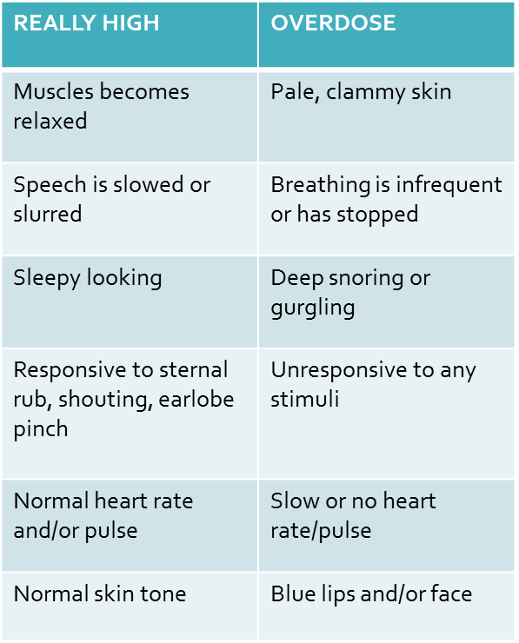
DISTINGUISH BETWEEN AN OVERDOSE AND SOMEONE WHO IS HIGH
Someone who is high might not be experiencing an overdose.
Look for these symptoms to determine if an overdose is occurring.
If unsure, call 9-1-1 and administer naloxone.

Slide 14
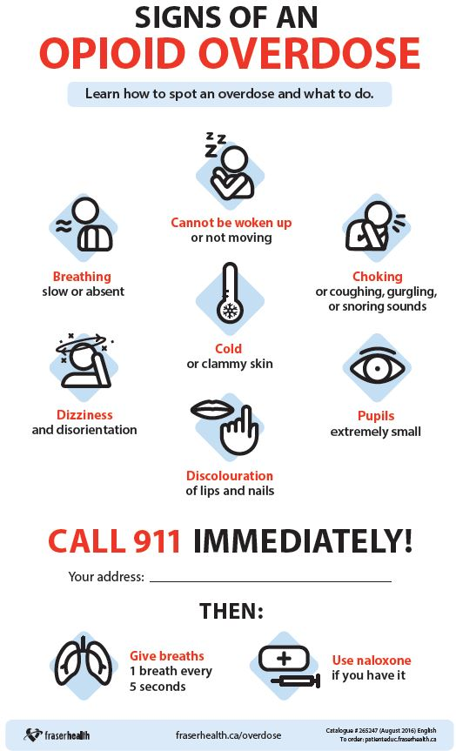
RESPONDING TO AN OVERDOSE
Step 3: Call 9-1-1 (or Step 4, whichever you can do quickest)
Step 2: Attempt to Arouse – Sternal Rub: Rub person’s sternum with knuckles
Step 4: Administer naloxone, Rescue Breathing
Step 5: Stay Until Help Arrives
Step 1: Recognize an overdose

Slide 15
OVERDOSE TRAINING VIDEO Please Pause to Watch This Short Training Video
Source: Chicago Recovery Alliance, Sawbuck Films

Slide 16
WHY Naloxone?
Naloxone is safe
There is no potential for misuse or addiction.
It is as nontoxic as water.
Naloxone is effective
Naloxone reverses effects of an overdose.
Anyone in Illinois can be trained to administer naloxone.
It will not hurt someone who has not taken opioids.

Slide 17
Naloxone Facts
Onset of action is about 2-3 minutes
Duration of action is 30-120 minutes depending on method of administration
It only reverses overdoses caused by opioids
May be used in children and pregnant women
Expired naloxone can still be administered
It may not be as effective, and a second dose may be required.

Slide 18
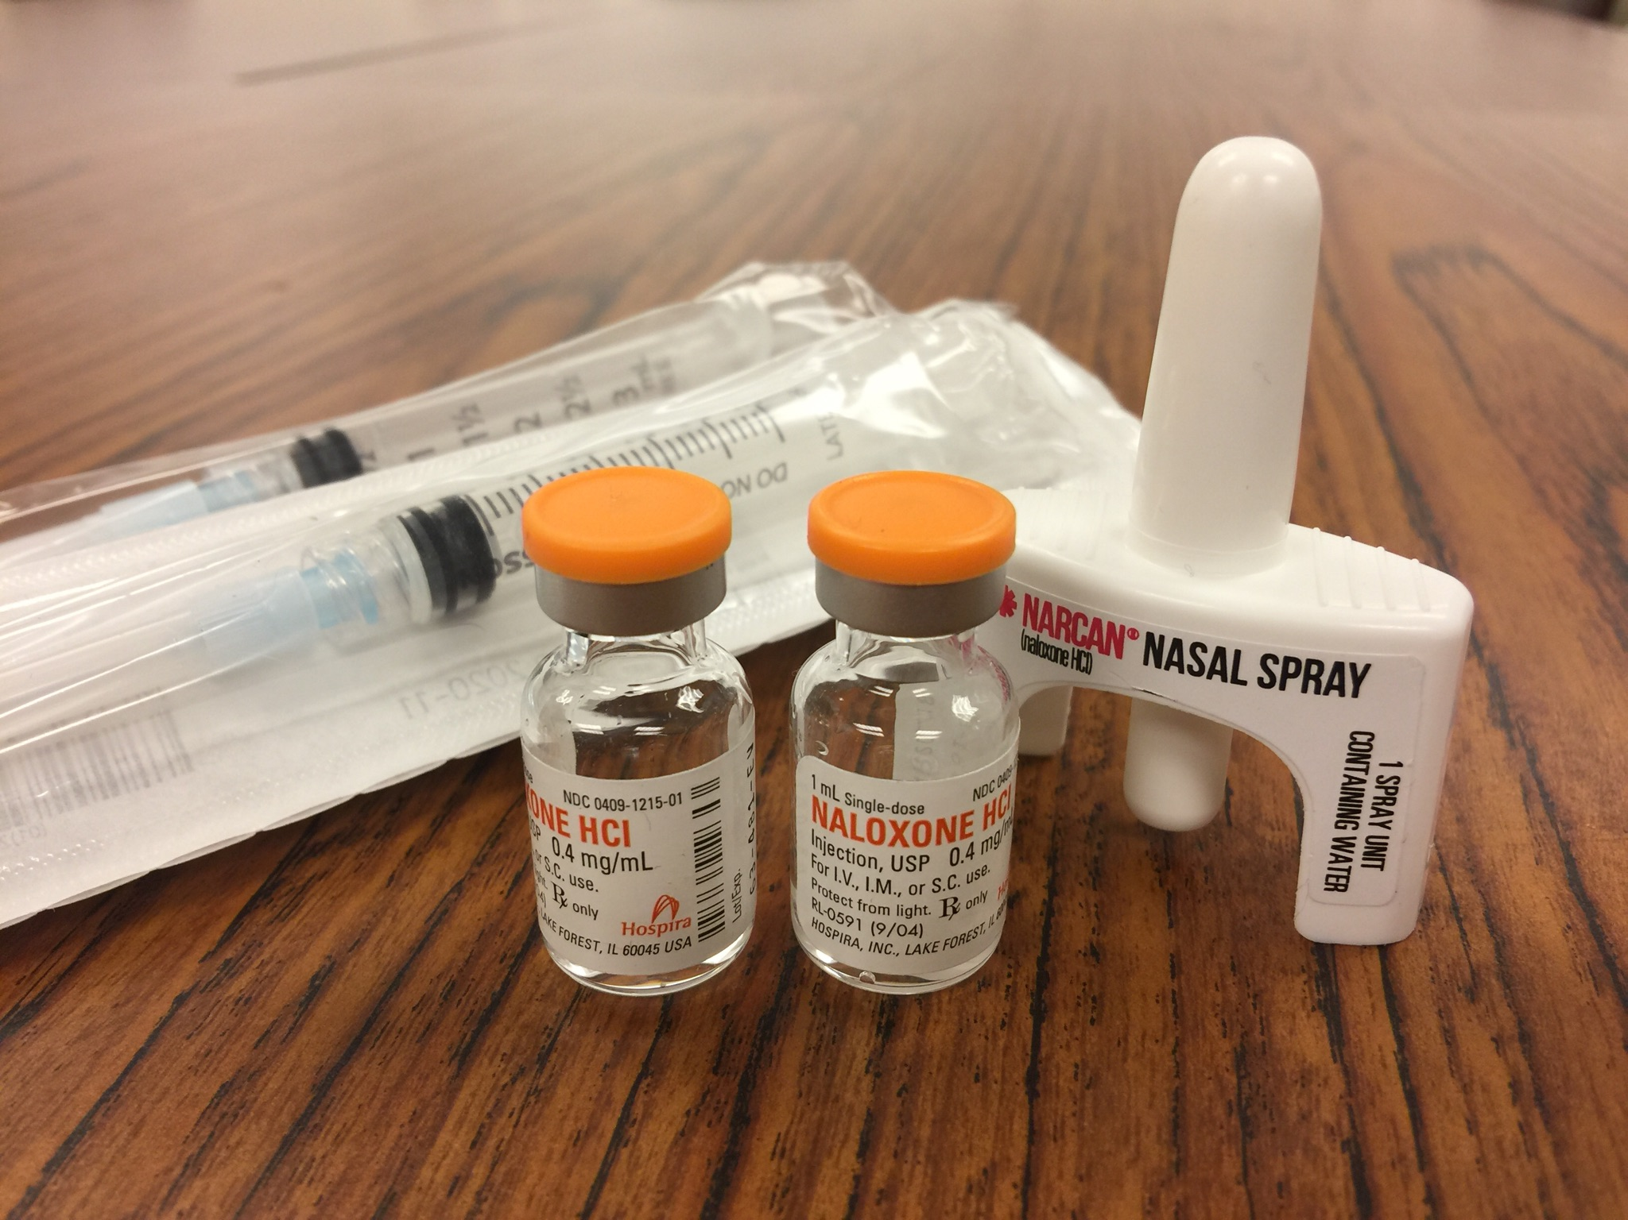
2 Ways to Administer Naloxone
Injectable (intramuscular – IM)
Auto injector (Evzio brand)
Syringes
Nasal (intranasal – IN)
Narcan brand

Slide 19
HOW TO ADMINISTER INJECTABLE NALOXONE

Slide 20
How to give nasal spray Naloxone
In the case of a known or suspected opioid overdose:
1. Peel back the tab to remove NARCAN® Nasal Spray from its package.
2. Place the device into one nostril.
3. Press the device plunger firmly.
4. Get emergency help right away. If no response after 2-3 minutes, give a second dose in the other nostril.

Slide 21
Narcan Training Video
Please pause the training to watch this short video demonstrating how to administer Narcan nasal spray.
Source: Adapt Pharma

Slide 22
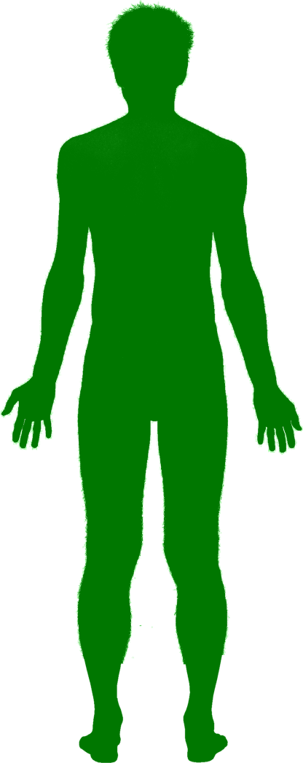
Check your learning
Can you identify where to administer naloxone?
Click on an area of the body where naloxone can be injected into the muscle

Slide 23
Great job!
Naloxone can be injected into a muscle in the person’s arm or leg

Slide 24
Remember…
You do not need to remove their clothing to administer naloxone.
If the first dose does not work within 2-3 minutes, give a second dose and begin rescue breathing again.
If the person is still unresponsive, make sure to lay them in the recovery position, on their side, to prevent choking and wait for help.

Slide 25
Rescue Breathing
Check that the person’s airway is clear
Place one hand on the person’s chin, tilt the head
Pinch the nose closed
Place your mouth over the person’s mouth to make a seal and give 2 slow breaths.
The person’s chest should rise (but not the stomach).
Follow up with one breath every 5 seconds until the person can breath on their own
1
2
3
4
5
6

Slide 26
While you’re waiting for naloxone to kick in…
Wait 2-3 minutes to give the medication a chance to work.
If no response after 2-3 minutes, give a second dose of naloxone and begin rescue breathing again.
If still no response, continue rescue breathing until paramedics arrive and let them take over.
Note: naloxone will only work if the individual has taken an opioid.
Start rescue breathing until you see the person start to breathe on their own.

Slide 27
After administration of naloxone…
Stay with the person for as long as you can or until help arrives.
If the person is still unresponsive, lay them in the recovery position.
Explain what has happened
The person may experience withdrawal symptoms
If the person is responsive, they will be confused and will probably not remember overdosing.
Some people may become agitated or combative
Comfort the person

Slide 28
Summary – Do’s and Don’ts
DO…
Support the person’s breathing by performing rescue breathing
Administer naloxone
Put the person in the “recovery position”, on their side
Stay with the person and keep him/her warm
DON’T…
Slap or try to forcefully stimulate the person
Inject the person with any substance other than naloxone
Put the person into a cold bath or shower
Make the person vomit what he/she may have swallowed

Slide 29
WHERE TO FIND NALOXONE
Illinois Department of Public Health Data Dashboard Naloxone Distributor Locator:
https://idph.illinois.gov/OpioidDataDashboard/
Ask your medical provider or pharmacy: CVS, Walgreens,
Go to
getnaloxonenow.org
Illinois helpline for opioids and other substances:
Helplineil.org
Ideally, naloxone should be available in these settings:
Syringe Exchange Programs
Jails
Hospital Emergency Departments
Free Clinics
First Responders
Friends and Family members
Methadone, Suboxone and Other Treatment Programs

Slide 30
IMPORTANT RESOURCES
Videos Used in This Training:
Your Brain on Opioids (National Geographic)
https://youtu.be/NDVV_M__CSI
Naloxone Training Video (Chicago Recovery Alliance)
https://youtu.be/3epkpT-V6c0
Narcan Administration Video
https://youtu.be/tGdUFMrCRh4
Drug Overdose Prevention Program (DOPP)
Illinois helpline for opioids and other substances:
https://helplineil.org/

Slide 31
Congratulations!
You have completed the Naloxone Training. Click the link below to test your knowledge and receive your training certificate.
Training Quiz

